Slide 1


18MAT399
Forecasting global demographics:
Time Series Analysis of Population Growth
STUDENT: GAYATHRI S Int. MSc MATHEMATICS CB.SC.I5MAT21004
PROJECT SUPERVISOR: Dr. DIYA BHATTACHARYYA Asst. PROFESSOR DEPARTMENT OF MATHEMATICS

Slide 2
Statement of the Problem
To utilise various time series models for analysing the population growth of different countries, i.e.,
To predict the population of the countries in 2025 using the time series model that is identified to be the best.
To estimate the rate of increase or decrease in population growth, as well as identify possible demographic factors behind them.

Slide 3
Motivation of the Work
It is essential to analyse population growth, because it has huge effects on society, including on:
Economic Development
Social Development (Healthcare, Education, Infrastructure, etc.)
Environment (Resource Depletion, Pollution, Climate Change, etc.)
Agriculture

Slide 4
INTRODUCTION

Slide 5
TIME SERIES
In time series, data is collected chronologically over time.
Components of Time Series:
1. TREND 2. SEASONALITY 3. CYCLE 4. NOISE

Slide 6
STATIONARY TIME SERIES
A stationary time series is one whose properties do not depend on the time at which the series is observed.
VARIANCE
MEAN
STATIONARY TIME SERIES
NON STATIONARY STATIONARY
DIFFERENCING
2. LOGARITHMS

Slide 7
DATA SETS USED
Time series data containing information on population from 1950-2022 for the following countries:
India [Source: https://en.wikipedia.org/w/index.php?title=Demographics_of_India&oldid=1215506264]
China [Source: https://en.wikipedia.org/w/index.php?title=Demographics_of_China&oldid=1214252480]
Russia [Source: https://www.macrotrends.net/global-metrics/countries/RUS/russia/population]
USA [Source: https://www.macrotrends.net/global-metrics/countries/USA/united-states/population]

Slide 8
MODELS

Slide 9
AR MODEL
AR MODEL
AR model uses past values for forecasting future data.
An autoregressive model of order p [AR(p)] can be written as
y_{t}=c+φ₁y_{t-1}+φ₂y_{t-2}+… +φ_{p}y_{t-p}+e_{t}
where e_{t} is white noise, y_{t} denotes the value of the variable at time t and φ_{i}’s are the model parameters.
Autoregressive model

Slide 10
MA MODEL
MA MODEL
MA model uses past errors for forecasting future data.
A moving average model of order q [MA(q)] can be written as
y_{t}=c+e_{t}+θ₁e_{t-1}+θ₂e_{t-2}+…+θ_{q}e_{t-q}
where e_{t} is white noise.
Moving Average model

Slide 11
ARMA MODEL
ARMA MODEL
ARMA model is a combination of both autoregressive and moving average models.
Autoregressive Moving Average Model

Slide 12
ARIMA MODEL
ARIMA MODEL
A non-seasonal ARIMA model is obtained by combining differencing with autoregressive and moving average models.
ARIMA model can be written as,
y_{t}=c+φ₁y’_{t-1}+φ₂y’_{t-2}+… +φ_{p}y’_{t-p}+θ₁e_{t-1}+θ₂e_{t-2}+…+θ_{q}e_{t-q} +e_{t}
ARIMA(p,d,q) model, where
p=order of the autoregressive part, d=degree of first differencing involved, q=order of the moving average part.
Autoregressive Integrated Moving Average Model

Slide 13
RESULTS

Slide 14
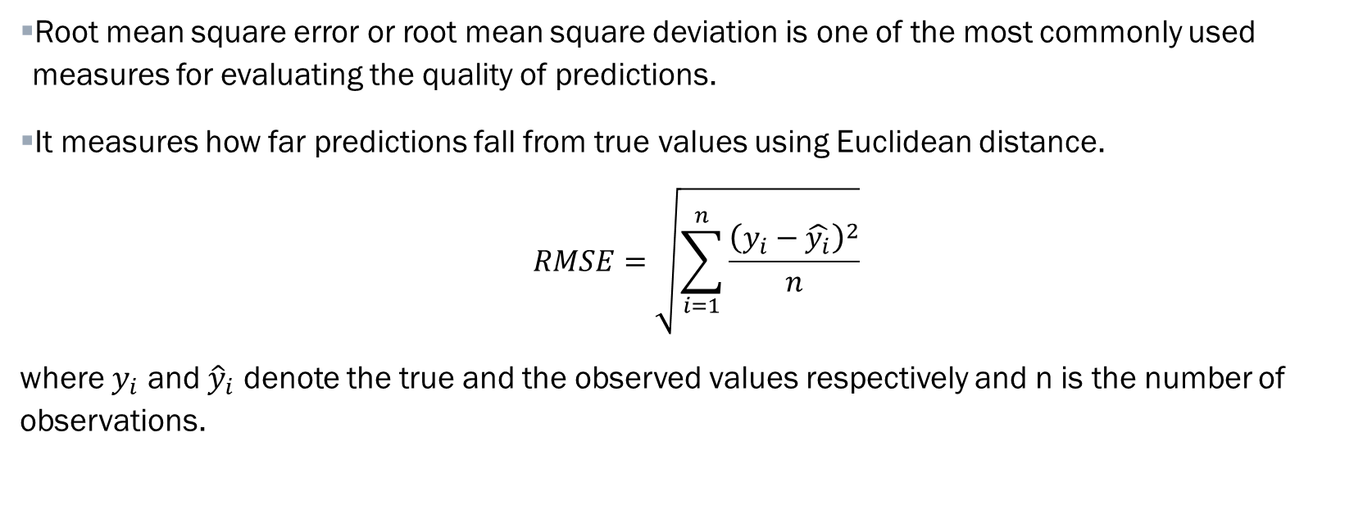
ROOT MEAN SQUARE ERROR (RMSE)
Root mean square error or root mean square deviation is one of the most commonly used measures for evaluating the quality of predictions.
It measures how far predictions fall from true values using Euclidean distance.
$$RMSE=\sqrt{\sum_{i=1}^{n}{\frac{{\left(y_{i}−\hat{y_{i}}\right)}^{2}}{n}}}$$
where $y_{i}$ and ${\hat{y}}_{i}$ denote the true and the observed values respectively and n is the number of observations.

Slide 15
Comparing different models using RMSE values for the different countries, we get:
 | AR MODEL | MA MODEL | ARMA MODEL | ARIMA MODEL
INDIA | 0.153180 | 3.078269 | 0.153180 | 0.001650
CHINA | 0.028514 | 1.375058 | 0.021955 | 0.019267
RUSSIA | 0.000814 | 0.130126 | 0.000814 | 0.000711
UNITED STATES | 0.001561 | 0.531007 | 0.001561 | 0.001212
As the RMSE values of different countries are least for ARIMA model, we can conclude that ARIMA is the best model for forecasting the future values for these countries.

Slide 16
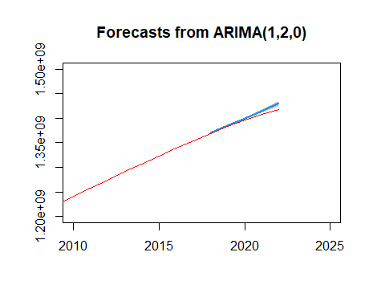
INDIA

Slide 17
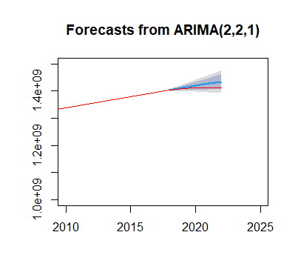
CHINA

Slide 18
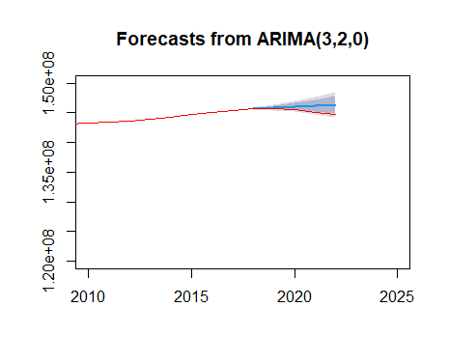
RUSSIA

Slide 19
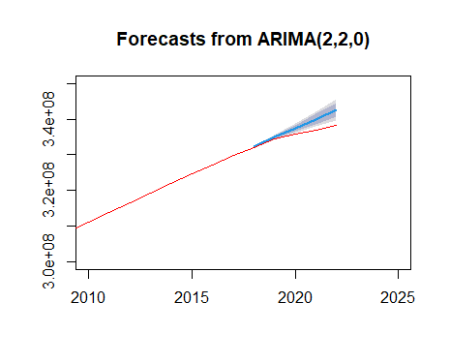
UNITED STATES

Slide 20
The predicted values of population and percentage of change of these countries in 2025 are tabulated below:
 | PREDICTED VALUES FOR 2025 | PERCENTAGE OF CHANGE*
INDIA | 1437919451 | 1.4639
CHINA | 1408767553 | -0.2113
RUSSIA | 144194015 | -0.3588
UNITED STATES | 343872192 | 1.6501
* Negative values indicate % decrease

Slide 21
DISCUSSIONS

Slide 22
The demographic factors responsible for the decline in population of China and Russia may be explored. A few of them are listed below:
ONE-CHILD POLICY: In China, One-child policy was implemented in 1979 limiting most urban couples to only one child. Subsequently, it was relaxed to two-child policy and later to three-child policy in 2021.
ECONOMIC FACTORS: Economic pressures, such as the high cost of education, healthcare, and housing, also the pursuit of career opportunities and economic stability.
AGING POPULATION: It is due to increased life expectancy and decreased birth rates. Also, it decreases the proportion of working-age individuals.
LOW BIRTH RATE: Russia has experienced consistently low birth rates over the past few decades.
HIGH MORTALITY RATE: Alcoholism, smoking, poor healthcare infrastructure in rural areas, and the prevalence of diseases like HIV/AIDS and tuberculosis results in increasing the mortality rate among working-age individuals.
EMIGRATION: In Russia, lack of economic opportunities and political stability leads to people, especially among skilled workers and young professionals.

Slide 23
CONCLUSIONS

Slide 24
CONCLUSIONS
From our analyses, we can draw the following conclusions:
Among the countries analysed in this study, India is predicted to have the highest population in the year 2025 with a population growth of 1.46%.
Russia is predicted to have the least population in the year 2025 with a population decrease of 0.36%.
United States is predicted to have the highest population growth rate, i.e., 1.65%.

Slide 25
REFERENCES
Box, G. E., Jenkins, G. M., Reinsel, G. C., & Ljung, G. M. (2015). Time series analysis: forecasting and control. John Wiley & Sons.
Dai, J., & Chen, S. (2019, October). The application of ARIMA model in forecasting population data. In Journal of Physics: Conference Series 1324. IOP Publishing.
R Core Team (2022). R: A language and environment for statistical computing. R Foundation for Statistical Computing, Vienna, Austria. URL https://www.R-project.org/.
Shumway, R., & Stoffer, D. (2019). Time series: a data analysis approach using R. CRC Press.

Slide 26
THANK YOU

